Slide 1
Students Activities
Department of Artificial Intelligence & Data Science
Academic Year 2023-24

Slide 2
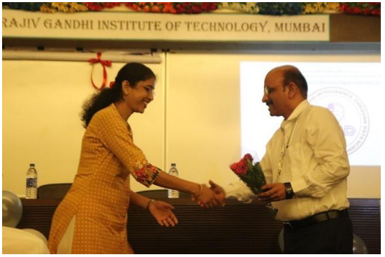
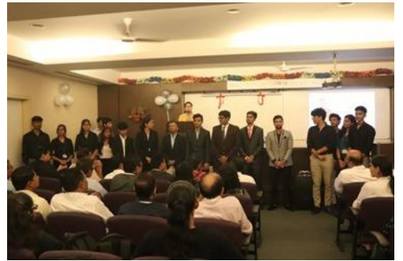
Inauguration Ceremony of
Professional Body – “CRID” (7/08/22)

Slide 3
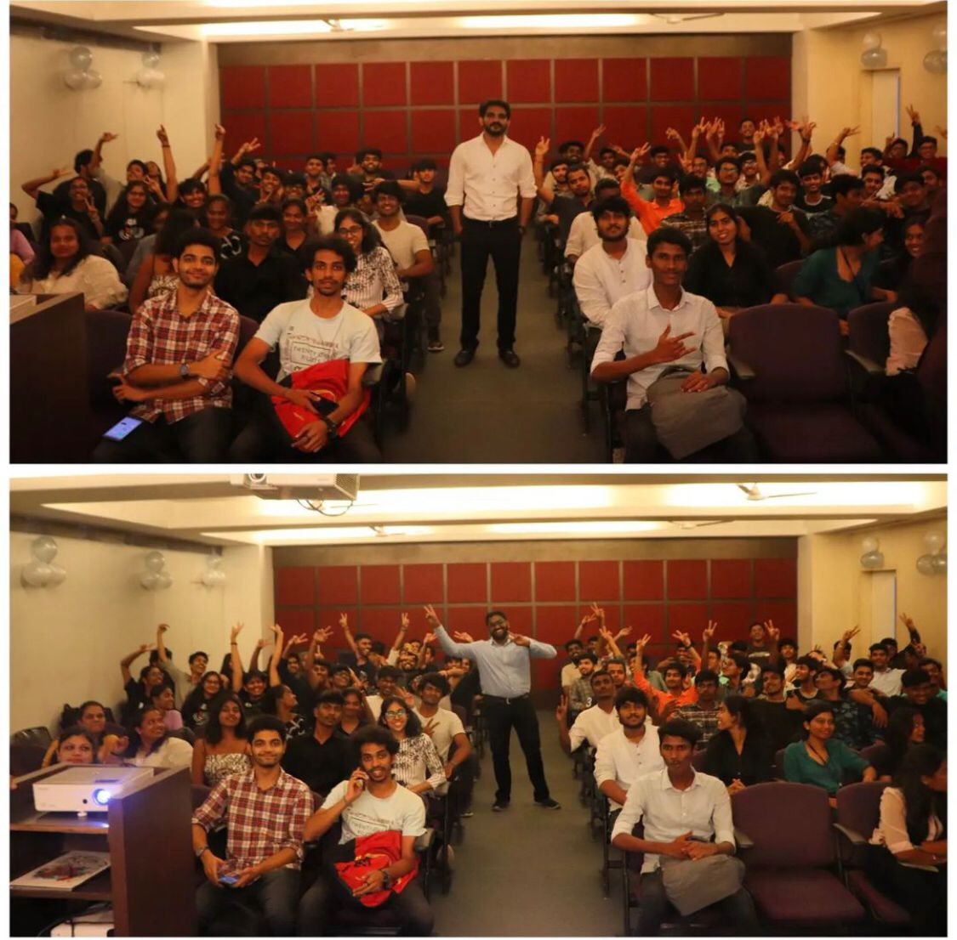
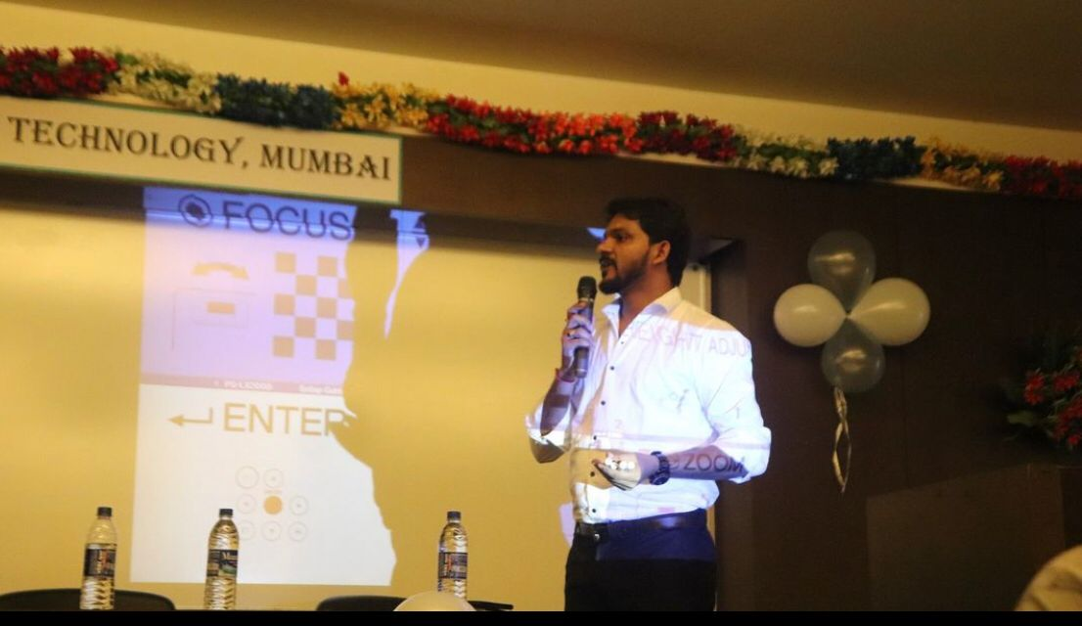
Crux of Data science (7/10/22)

Slide 4
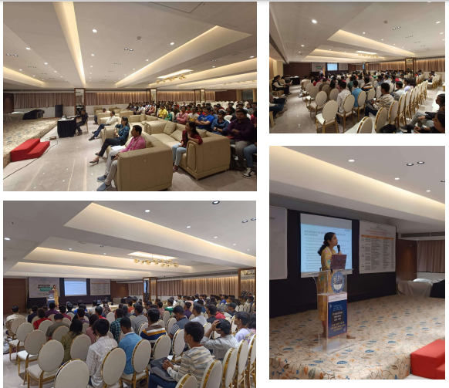
FE INDUCTION PROGRAM-15/11/22

Slide 5
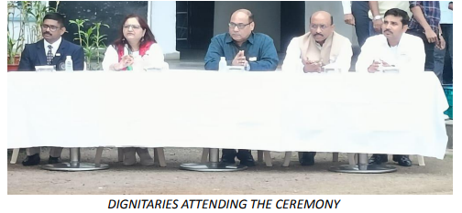
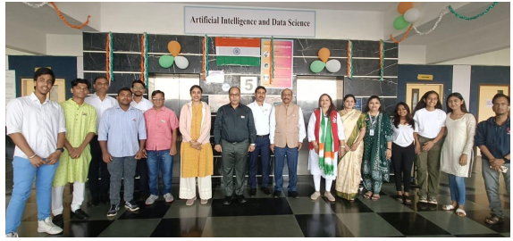
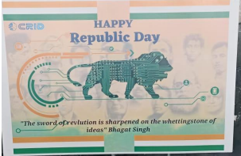
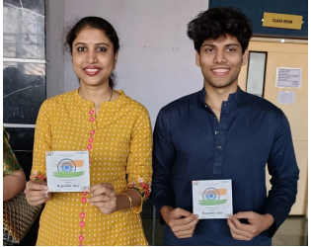
REPUBLIC DAY REPORT 2023 (26/01/23)

Slide 6
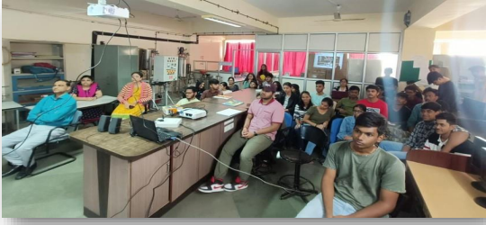
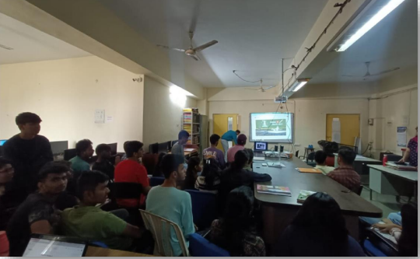
Pariksha Pe Charcha (27/01/23)

Slide 7
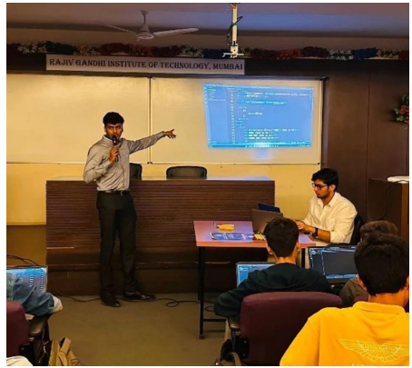
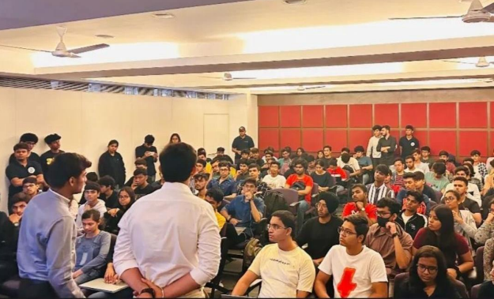
Web Development Bootcamp (31/01/22)

Slide 8
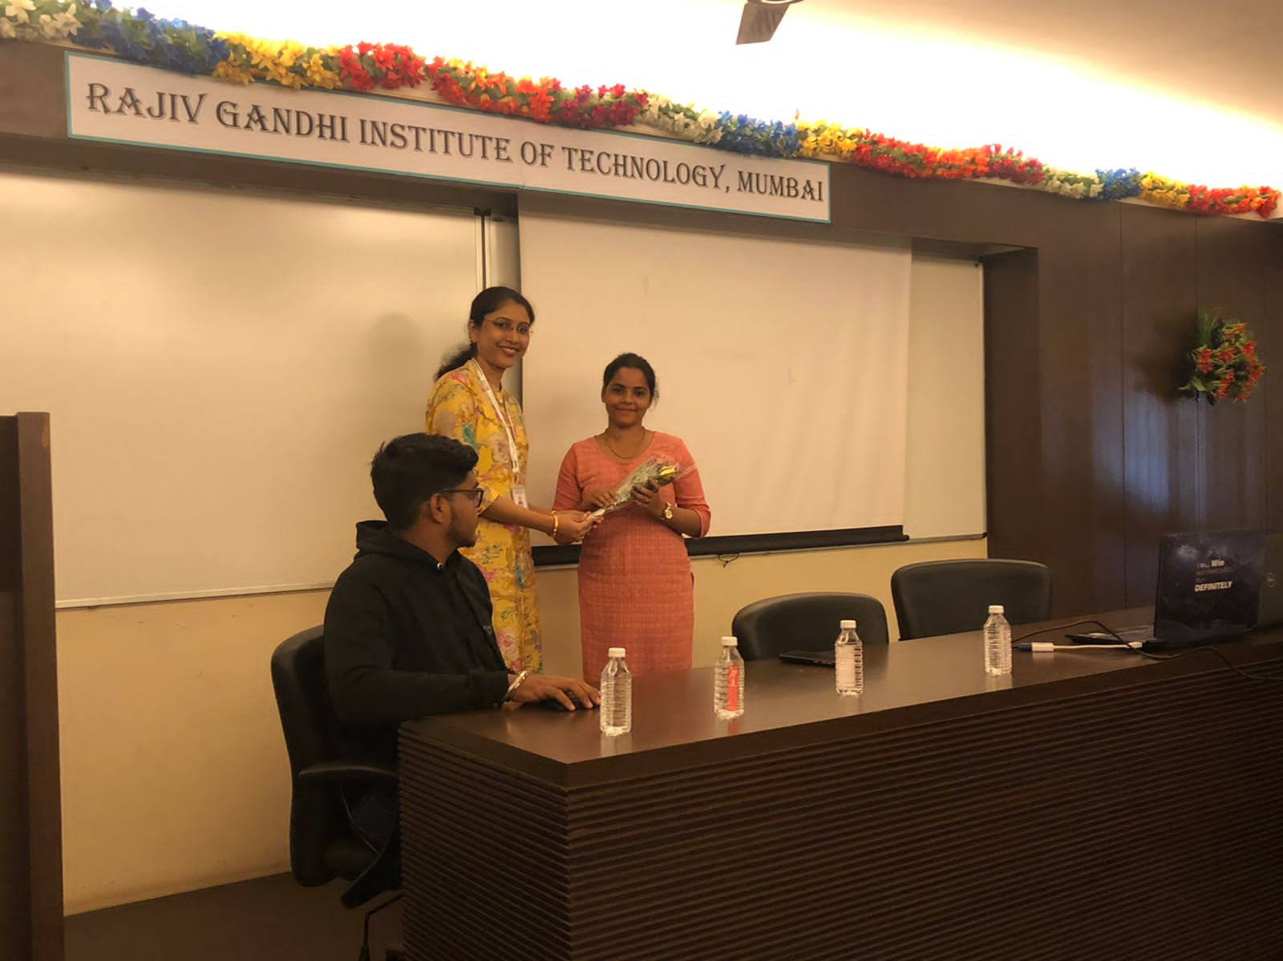
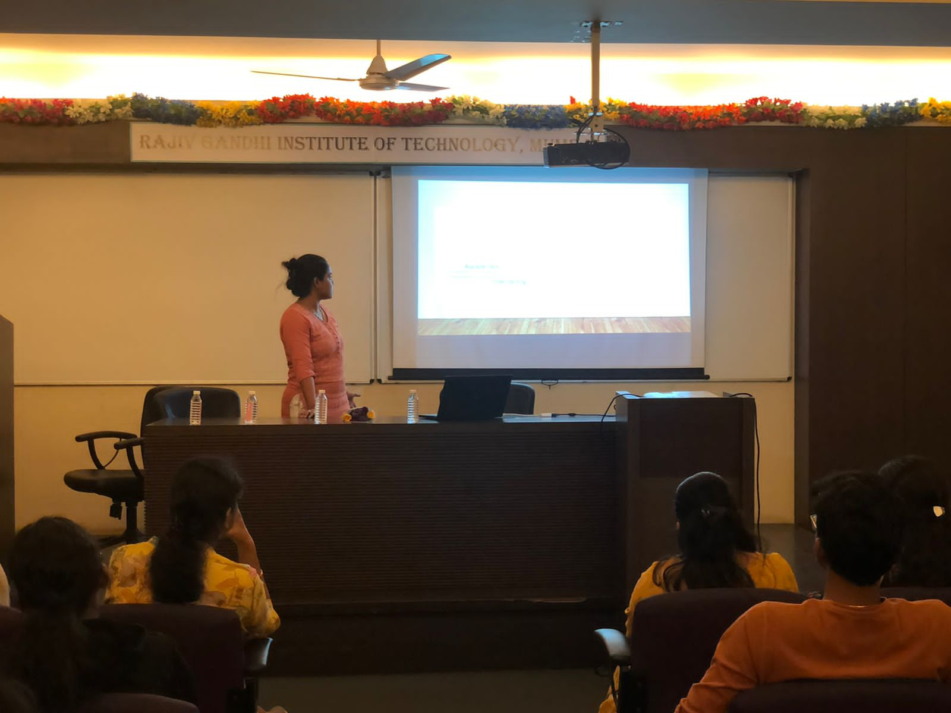
MICROSOFT POWER BUSINESS INTELLIGENCE-9/2/23

Slide 9
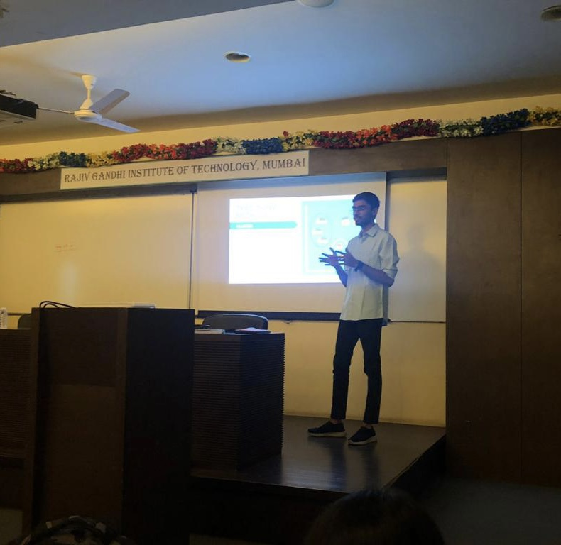
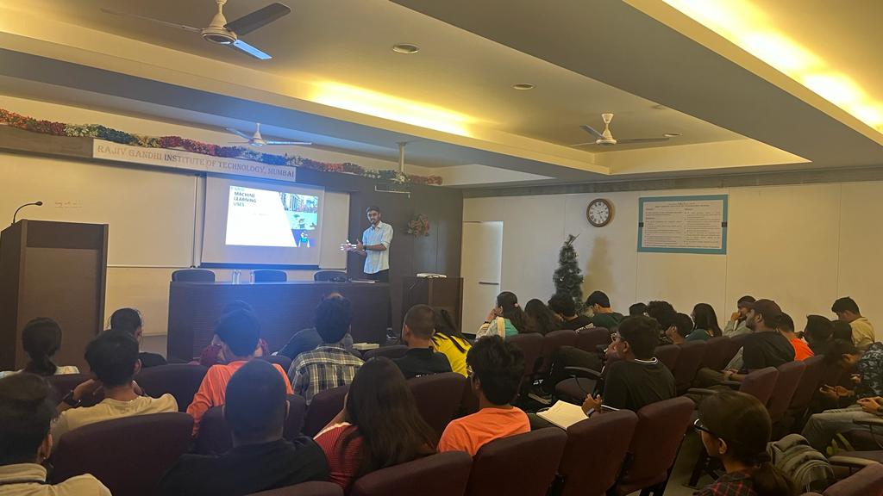
Data Science Bootcamp-15/2/23

Slide 10
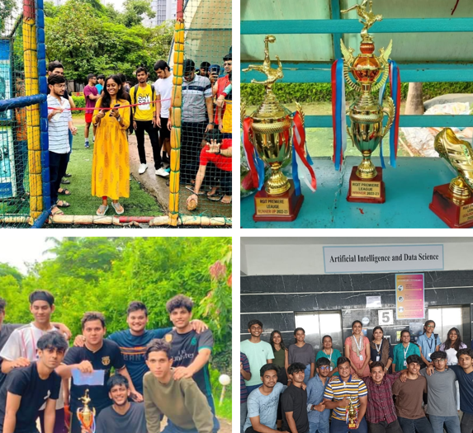
RGIT Football Premier League

Slide 11
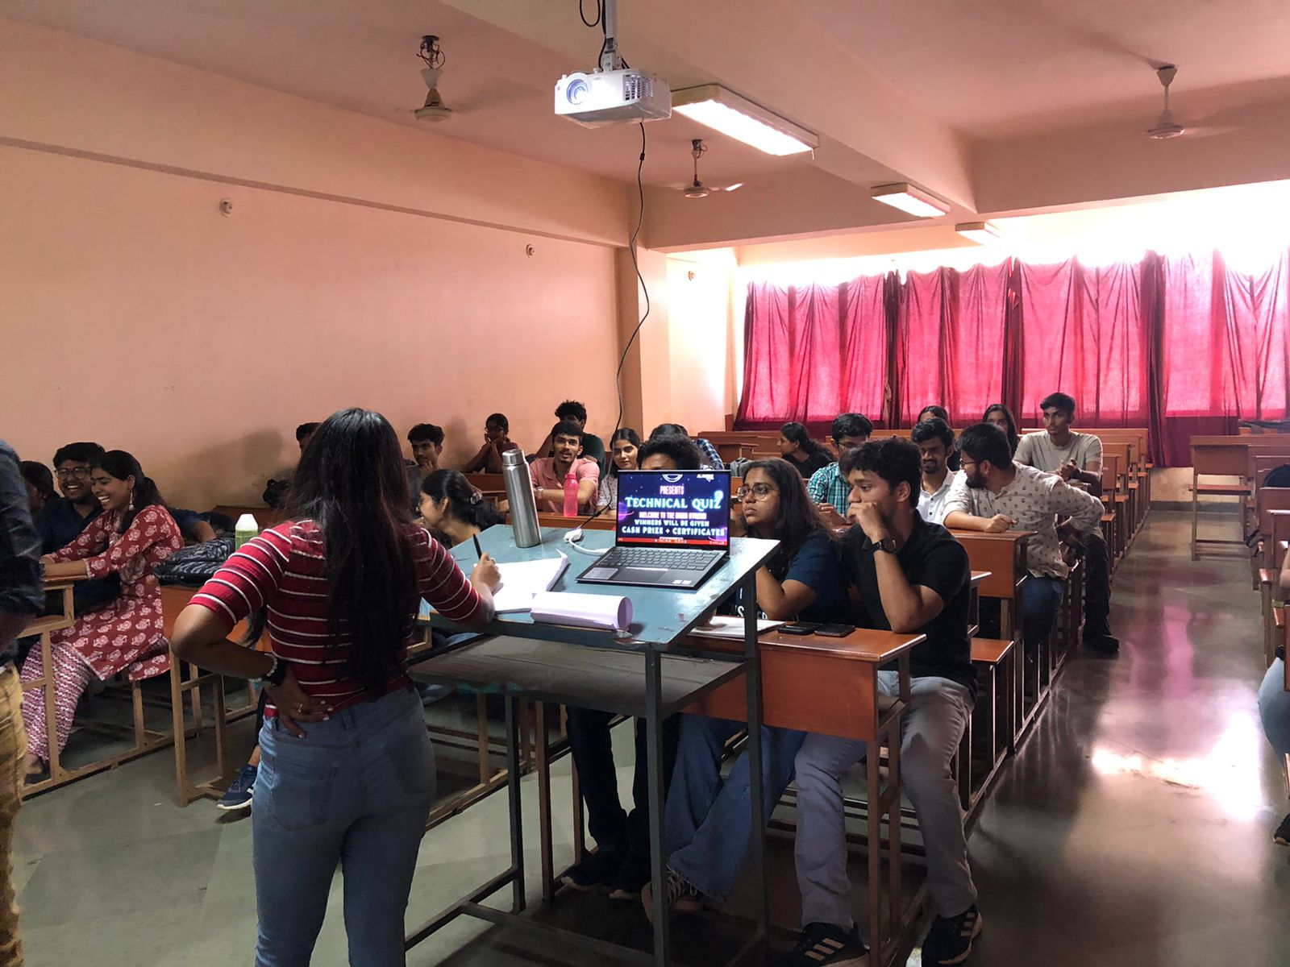
Technical Quiz-23/03/23

Slide 12
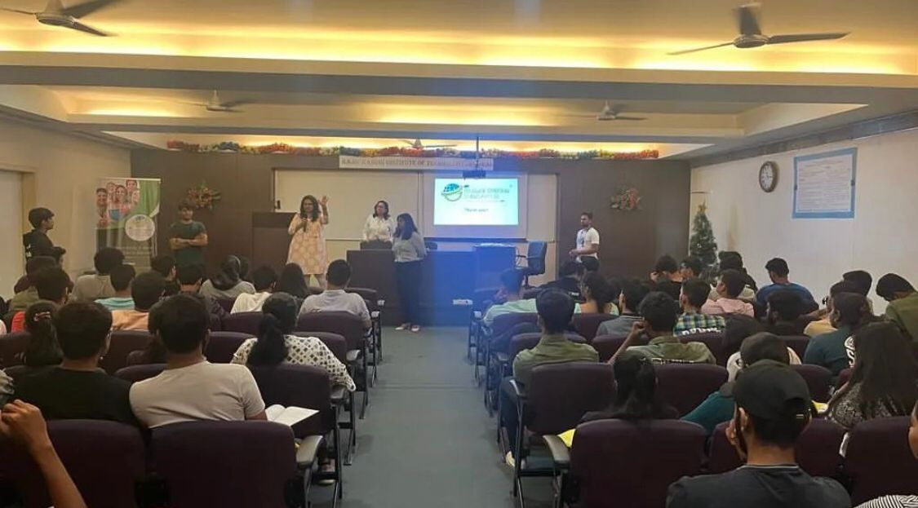
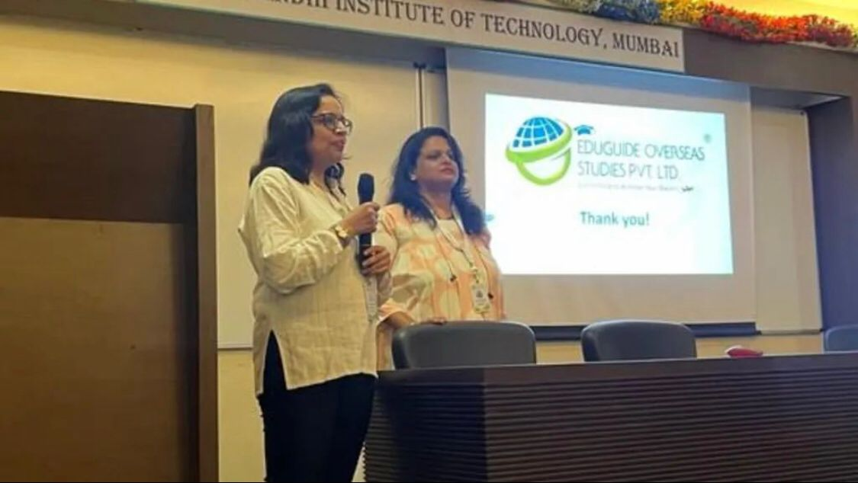
Overseas Studies-14/03/23

Slide 13
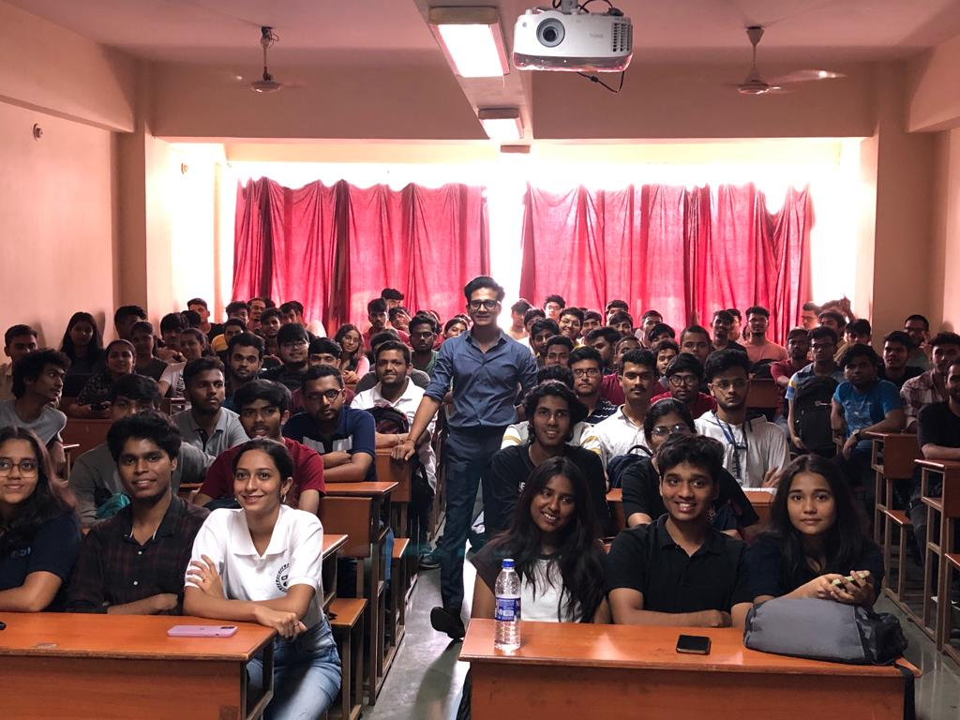
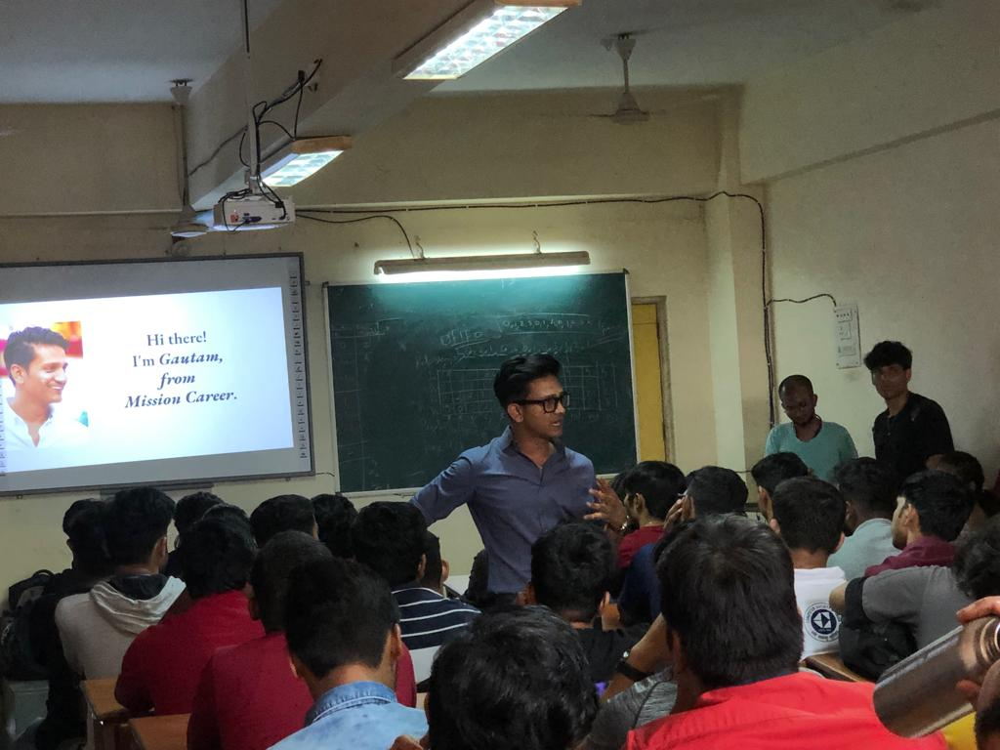
Mission Carrier-10/03/31

Slide 14
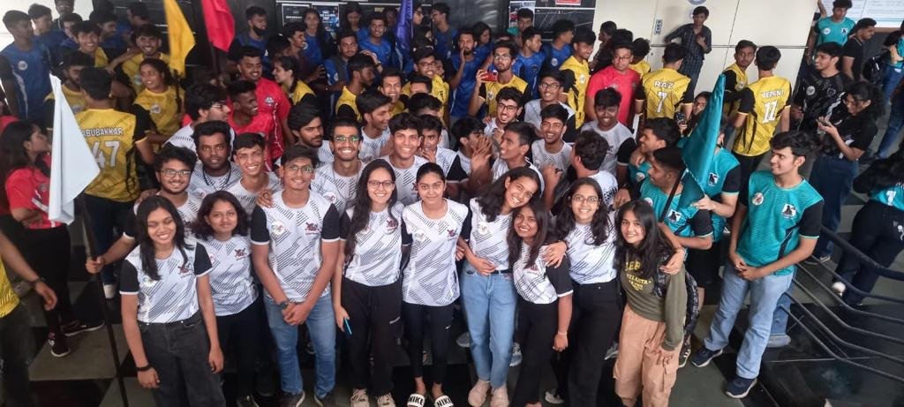
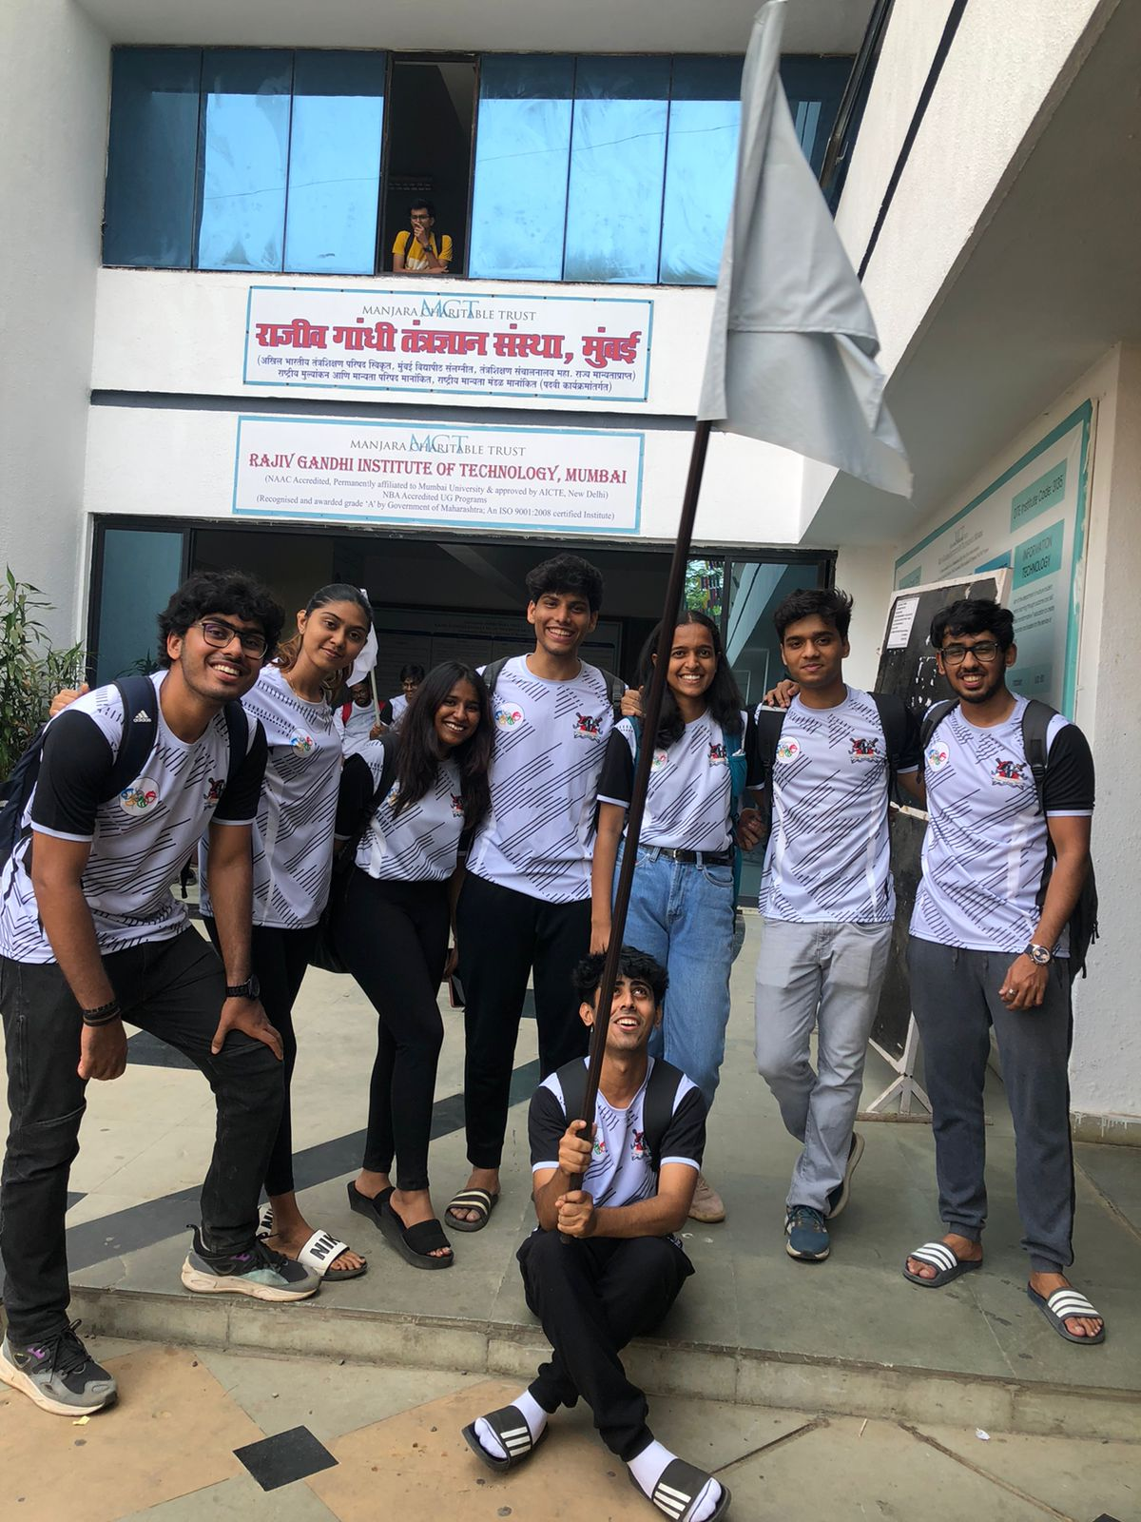
RGIT Olympia-6/03/23

Slide 15
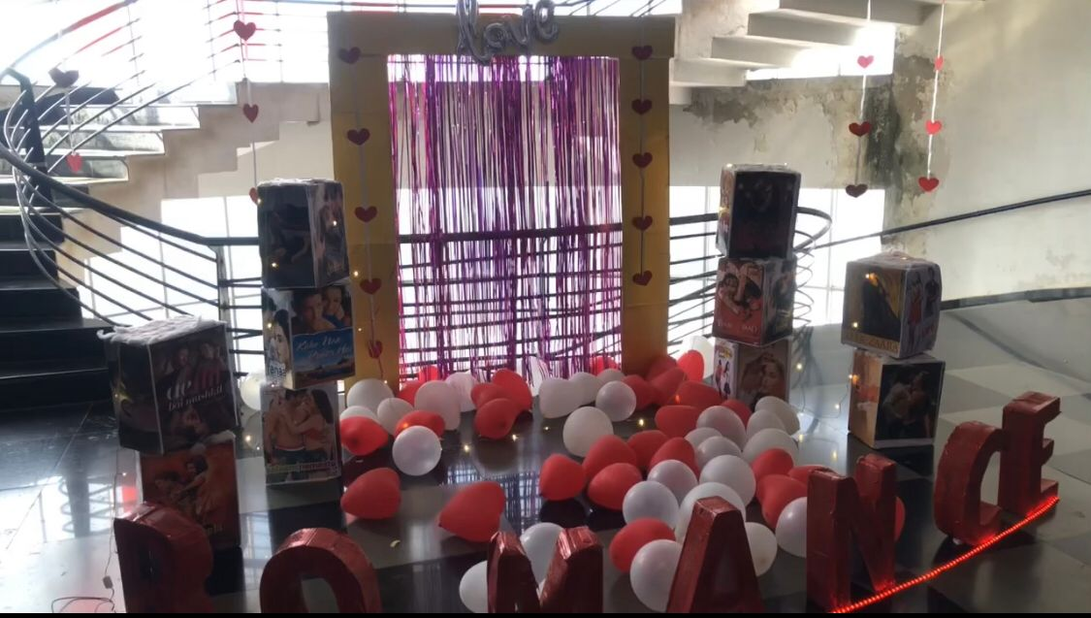
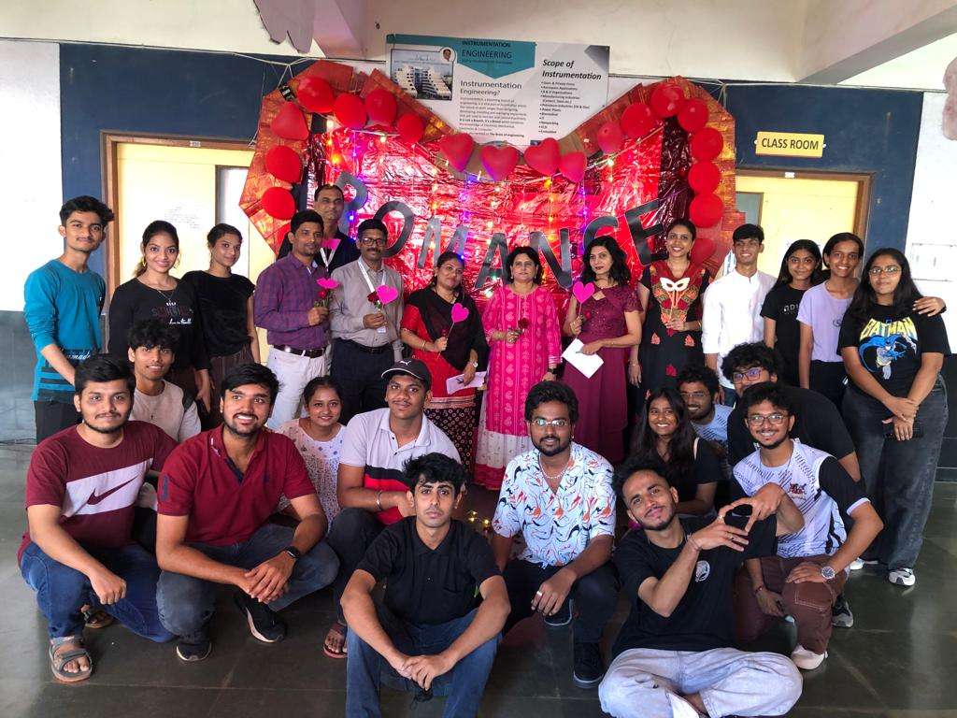
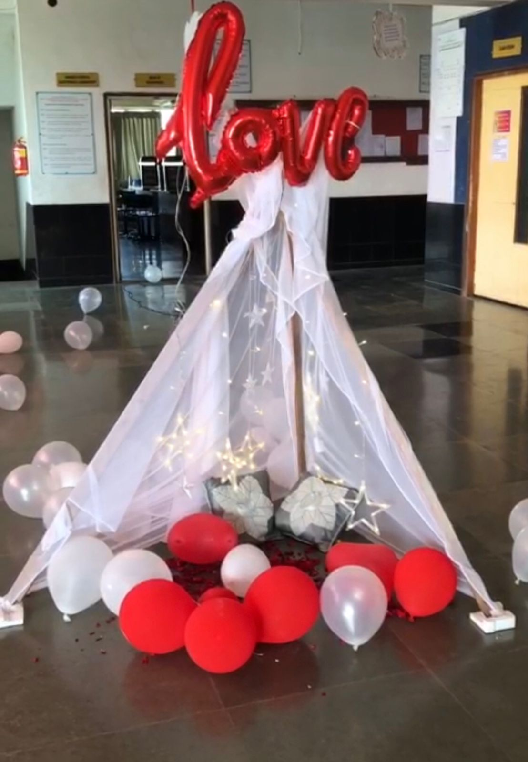
Floor Decoration(Theme-Romance)-28/03/23

